Slide 1








Welcome October 23, 2015
Brought to you by Our Sponsors!

Slide 2
USING REST AND SPEECH TO TRANSCRIBE .wav FILES IN YOUR INBOX
Rob Koch
@robcube
Denver Dev Day
October 23, 2015

Slide 3

AGENDA
REST
Need Web API primer?
Office 365
Getting down and dirty

Slide 4

WHY REST? WHAT IS REST?

Slide 5
REST: REpresentational State Transfer
Less chatty than SOAP
Most tools can use it
Basically simple HTTP calls
Data coming back can be anything
Just say no to XML!
Downside – no metadata like WSDL

Slide 6


Slide 7
REST Call using Web API
Quick demo to get your head wrapped right?
What are some of the Http… classes?

Slide 8
REST / WebAPI demo Using Visual Studio 2015 NuGet Show the Http… classes

Slide 9
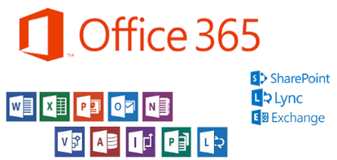
WHAT IS OFFICE 365?
New iteration of the Microsoft-money making machine.
Well, it’s also a money making machine for us DEVS!
(I’ll explain in a bit if we have time.)

Slide 10

Pushing the Easy Button https://dev.office.com/
Register for Office 365 account
Register for an Application ID
Get not-so-top secret App ID
Get top secret key
Download code

Slide 11
Downloading sample code
Watch out…
Path may be too long
Don’t share code with others

Slide 12

My little 365 app
What it will do:
Read through Outlook 365 Inbox
Look for attachments
Find .wav files by file type
Transcribe using .NET System.Speech Library

Slide 13
Let’s see Rob code!

Slide 14
A story to tell…
Caveat: your live.com/outlook.com mailboxes might not have REST APIs enabled yet. Being updated in batches.
-- Jason Johnston (@JasonJohMSFT)
Remind me to tell you a story….

Slide 15
Office 365 App Store
There’s another session earlier that discuss Opportunities. If you missed it, you can go find Sean McNeill or go to http://dev.office.com/opportunity to research.

Slide 16
Thanks to my employer, McGraw-Hill Financial, for letting me share this with you!
Offices in downtown Denver and DTC. Yes, we’re looking for people!

Slide 17
Code in this session: http://github.com/robcube
Twitter: @robcube
DDD2.1
DDD2.2

